Slide 1
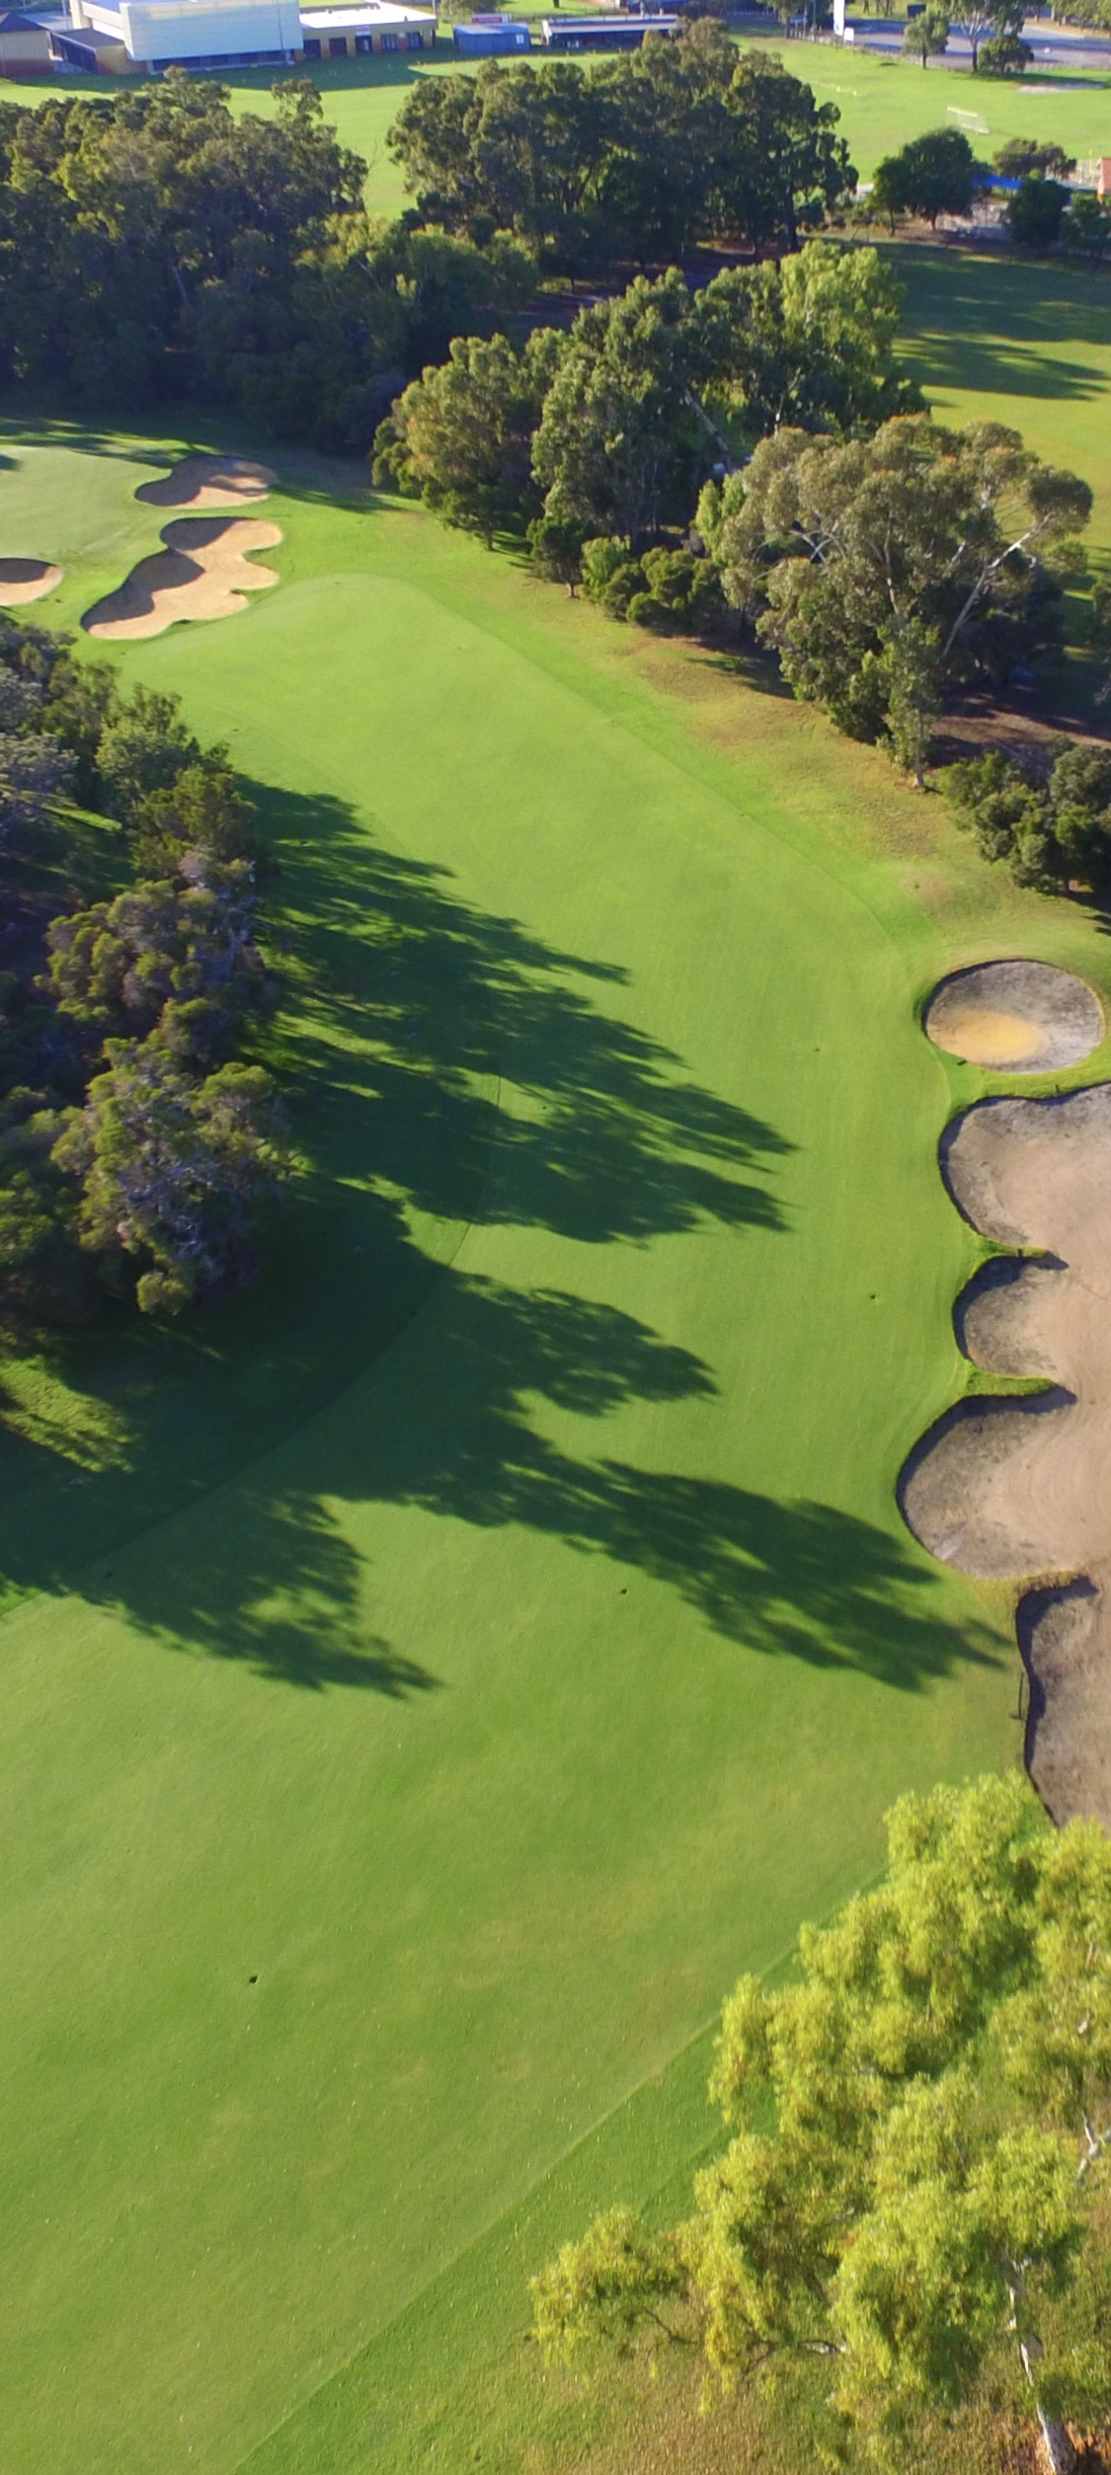

Golf Course Superintendents Association of Western Australia
Association Sponsorship
Prospectus
2023 - 2024

Slide 2

Golf Course Superintendents Association of Western Australia (GCSAWA)
About the GCSAWA
The Golf Course Superintendents Association of Western Australia (GCSAWA) is an association dedicated to the professional development of sports turf managers.
With a strong and dedicated membership base of professional turf managers, the association supports industry professionals in the production of quality turf playing surfaces at Sport & Recreation facilities throughout Western Australia.
The Association’s operations are managed by a volunteer committee of members, working to further opportunities for professional turf managers.
Since its inception, the aim of the Golf Course Superintendents Association of Western Australia has been to provide Course Superintendents, Assistants, Ground Staff and Apprentices with an Association to provide support and education opportunities.
Our approach is to foster the growth and calibre of services, recognise the needs of members, encourage ongoing communication and engagement within the turf industry, promote accessibility to those in regional areas and offer engaging opportunities to network with members and trade partners.
The standards demanded on golf courses have increased dramatically and the need to continue supporting and providing education opportunities, understand developments in technology and products, and communicate with other turf professionals has become even more important.
Kalgoorlie Golf Course, WA

Slide 3
Golf Course Superintendents Association of Western Australia
Sponsorship Opportunities
Involvement as a sponsors of the GCSAWA assists us to provide educational events for our members, networking opportunities and member support - all with the aim of promoting the Turf Industry and the professional development of its members
The GCSAWA committee works in conjunction with Members and Sponsors, to develop a program that delivers a valuable resource for organisations, offering sponsors the opportunity to engage with industry members and develop relationships with new and existing events and opportunities.
The Association has three tiers of Sponsorship on offer - Gold, Silver and Bronze.
Gold - $4,000 (max. of 5)
One complimentary registration at the GCSAWA Margaret River Conference (bi-annual)
4 other company staff at Superintendents rate
20 minute presentation at the Margaret River Conference
Company logo on shirts for Margaret River Conference
One free Trade Challenge team each year
One free hole sponsorship at the Trade Challenge each year
Naming rights to 1 selected GCSAWA event annually (“Brought to you by”)
Company Logo displayed on all GCSAWA emails and event correspondence
Display of pull up banners at all GCSAWA events
4 x Social Media Sponsored Posts annually
Company Logo and Link on GCSAWA website
GCSAWA support and advertising for your own company events
2 free tickets to the Golf Industry Awards Night
Silver - $2,000
Superintendents rate for 2 company representatives at the Margaret River Conference
One free team at the Trade Challenge
One free hole sponsorship at the Trade Challenge
Company Logo displayed on all GCSAWA emails and event correspondence
Display of pull up banners at all GCSAWA events
2 x Social Media Sponsored Post annually
Company Logo and Link on GCSAWA website
1 free ticket to the Golf Industry Awards Night
Bronze - $1,000
Superintendents rate for 1 company representative at the Margaret River Conference
Company Logo displayed on all GCSAWA emails and event correspondence
Display of pull up banners at all GCSAWA events
Company Logo and Link on GCSAWA website
1 x social media post annually
1 free ticket to the Golf Industry Awards Night

Slide 4

Golf Course Superintendents Association of Western Australia
Sponsorship Opportunities
Involvement as a sponsors of the GCSAWA assists us to provide educational events for our members, networking opportunities and member support - all with the aim of promoting the Turf Industry and the professional development of its members
The GCSAWA committee works in conjunction with Members and Sponsors, to develop a program that delivers a valuable resource for organisations, offering sponsors the opportunity to engage with industry members and develop relationships with new and existing events and opportunities.
The Association has three tiers of Sponsorship on offer - Gold, Silver and Bronze.
The GCSAWA have developed these sponsorship packages to provide an opportunity for companies at all levels to support the sports turf management industry, support members and be involved with the Golf Course Superintendents Association of Western Australia
.
To enquire or book a sponsorship package,
contact the GCSAWA on gcsawa@bigpond.com
Or contact –
Shane Baker
President
Golf Course Superintendents Association of
Western Australia
0417 175 217
The Cut, Vawesville, WA

